Slide 1
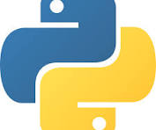
Python Programming
https://peps.python.org/pep-0008/
By:Alamirew W.

Slide 2
Outline
Introduction
Programming
Computer programming
Python
Feature of python
Display statement
variable
Operators
Data type
Keyword

Slide 3
Introduction
Program : is set of instruction that tells a Something to do something.
Programming: a process of writing, debugging, executing and evaluating a program.
it is telling a Something what to do.
Being good at programming means you can make the something do what you want.
is the process of creating a set of instructions for a something to follow to perform a specific task or solve a problem

Slide 4
Computer
An Electronics device that perform an operation based on calculation.
It derived from the word “compute” which means calculate.
A computer is a device that can accept human instruction, processes it, and responds to it or a computer is a computational device that is used to process the data under the control of a computer program.
It is a machine or device that perform an operation based on instruction or program with the help of electricity based on the following Sequence:-
Input
Process
Output

Slide 5
Computer Programming
Computer Program : is set of instruction that tells a Computer to do something.
Computer Programming: a process of writing, debugging, executing and evaluating a Computer program.
it is telling a Computer what to do.
Being good at Computer programming means you can make the Computer do what you want.
is the process of creating a set of instructions for a Computer to follow to perform a specific task or solve a problem

Slide 6
…Cont.
Computer programming or coding is the composition of sequences of instructions, called programs, that computers can follow to perform tasks
A person who writes a program is Programmer.
“If you haven't tried programming yet, it is recommended to try the concepts described here yourself as you move along, starting with either Python as your first programming language.
Since the concepts are the same in all programming languages, you can learn the concepts first in one language, and then use the concepts you've learned in another programming language later”.

Slide 7
Programming Languages
Is a set of rule, style, standard, semantics, syntax to write ,debug,and execute program.
A programming language is how we write code, what keywords we use, to tell the computer what to do.
A programming language is a set of instructions and syntax used to create software programs.
A programming language is a formal language that specifies a set of instructions for a computer to perform specific tasks.
It's used to write software programs and applications, and to control and manipulate computer systems.

Slide 8
Some of the key features of programming languages
Syntax: The specific rules and structure used to write code in a programming language.
Data Types: The type of values that can be stored in a program, such as numbers, strings, and booleans.
Variables: Named memory locations or container that can store values.
Operators: Symbols used to perform operations on values, such as addition, subtraction, comparison, logical, conditional
Control Structures: Statements used to control the flow of a program, such as if-else statements, loops, and function calls.
Libraries and Frameworks: Collections of pre-written code that can be used to perform common tasks and speed up development.
Paradigms: The programming style or philosophy used in the language, such as procedural, object-oriented, or functional.

Slide 9
…Cont.
Programming language are written by high-level languages or low-level.
Programming Language
High Level
High level languages are nearly human languages that are more complex than the computer understandable language
Low Level
low-level language are The computer understandable binary language (the language of 0’s and 1’s) also called machine-understandable language

Slide 10
…Cont.
Some of programming languages are:
Python
C++
Javascript
Java
…

Slide 11
Introduction to Python
one of the most popular programming languages.
It’s one of the Example of high level Language.
A high-level language, used in web development, data science, automation, AI and more.
Backed by library support.
Known for its readability, which means code is easier to write, understand and maintain.

Slide 12
Feature of Python
Simple and easy to learn
Interpreted language
High level language
Cross platform
Open source
Extensive standard library
Object oriented
Support multiple paradigm
Portable
Dynamic typing
Scalable and extensive
Widely used

Slide 13
First Python Program
Display statement : the first program of python is to display the result of statement or the string.
Here is a simple Python code, printing a string Hello world.
print(“Hello Python”)
Output:
Hello Python

Slide 14
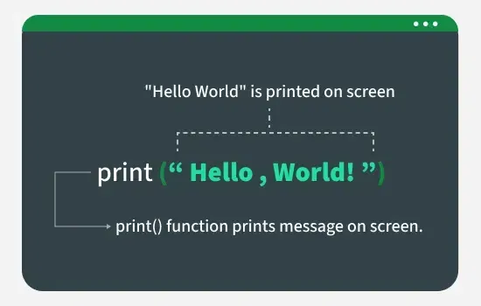
Opening Parenthesis
Closing Parenthesis
Opening Double quote
Closing double quote

Slide 15
Python Indentation
refers to the spaces at the beginning of a code line.
to indicate a block of code.
It tells the Python interpreter that a group of statements belongs to a specific block.
All statements with the same level of indentation are considered part of the same block.
Indentation is achieved using whitespace (spaces or tabs) at the beginning of each line.
The most common convention is to use 4 spaces or a tab, per level of indentation.

Slide 16
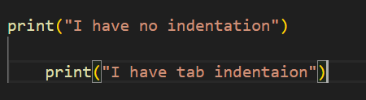

…Cont.
Example :-
Output
I have no indentation

Slide 17

Python Comment
A piece of text that is not executed by the compiler.
comments can be used to explain Python code.
Comments can be used to make the code more readable.
Comments can be used to prevent execution when testing code.
In python comment can be creating by “#”
Example:
On this, This is comment text is not displayed

Slide 18
Python Variable
Variables are containers for storing data values.
It is a memory location used to store values.
is a name that is assigned to a value.
is created the moment you first assign a value to it.
No require data type explicitly for names variable.
Example:
x = 5 y = "John“

Slide 19
…Cont.
A process of Giving names for variables is Variable Declaration .
A process of assign values for a variables is Variable Initialization.
Rule of Declaration:
Variable names must start with a letter or underscore
Example :
name = "Alice" # ✅ valid
_name = "Bob" # ✅ valid
2name = "Chris" # ❌ invalid
2. Data type is inferred automatically
num = 10 # int
num = "hello" # str (no error)

Slide 20
…Cont.
3. Variable names can only contain letters, numbers, and underscores
Example :
student1 = "John" # valid
student_name = "Mary" # valid
student-name = "Alex" # invalid
4. Variable names are case-sensitive
age = 20
Age = 30
print(age, Age) # Output: 20 30

Slide 21
…Cont.
5. Do not use Python reserved keywords as variable names
class = "CS101" # invalid
class_name = "CS101" # valid
6. Variables should have meaningful names (best practice)
x = 50 # unclear
student_age = 50 # clear and readable
7. . Python allows multiple assignment
x = y = z = 10 # All three get 10
a, b, c = 1, 2, 3 # a=1, b=2, c=3

Slide 22

Data Types
Variables can store data of different types, and different types can do different things.
The types of the value of a variable is Data type.
It represents the kind of value that tells what operations can be performed on a particular data.
To getting the data type of a variable , use type() function.
Example :
Output :

Slide 23
…Cont.
Python has the following data types built-in by default, in thesez categories:
Text Type: | str
Numeric Types: | int, float, complex
Sequence Types: | list, tuple, range
Mapping Type: | dict
Set Types: | set
Boolean Type: | bool
Binary Types: | bytes
None Type: | NoneType

Slide 24
Python String
A string is a sequence of characters.
Python treats anything inside quotes as a string.
This includes letters, numbers, and symbols.
Python has no character data type so single character is a string of length 1
Example :
Name=“alamirew”
Number=“123”
Chars=‘c’

Slide 25
Document string
It is used to declare multiple string like note.
Use “”” “””
Example :
name =“””my name is pyhton
High level programming language”””
String methods:
Index:to access single character
len:to know the number of character in a string
Upper:to convert the string to uppercase
Lowercase: to convert the string to lowercase
Slicing: to access the string to in range of character.
There are a lot of methods , read them!!!

Slide 26
Operators
Operators are symbols used to perform operations on variables and values.
standard symbols used for logical and arithmetic operations
the value on which the operator is applied is called Operand.
Operators in python
_{+,-*,/.%} | Arithmetic operators
<,>,<=,>=,==,!= | Relational operators
and, or, not | Logical operators
&,|,<<,>>,-,^ | Bitwise operators
=,+=,-=,*=,/=,%= | Assignment operators
input/print | Input /output operators

Slide 27
Please read the syntax, semantics, and output of each operators by exercising a lot!!!

Slide 28
Python Keywords
Keywords in Python are reserved words that have special meanings.
That serve specific purposes in the language syntax.
Python keywords cannot be used as the names of variable, function or class.
They are all written in lower case.
Have color on editors(example : green)
Example :

Slide 29
Thank you !!!

